Slide 1
Hemispheric 2016 Predicted Ozone
Presented by: Barron H. Henderson
OAQPS AQMG: Henderson, Dolwick, Jang, Misenis
OAQPS EIAG: Eyth, Vukovich
ORD: Mathur, Hogrefe, Pouliot
And more!

Slide 2
Outline
Overview
CMAQ Results and Evaluation
2016 Modeling Platform
Global model versions and options
Emissions
Natural
Anthropogenic
Seasonal Average Ozone
Sonde Evaluation
CASTNet Evaluation
Tropospheric Ozone Assessment Report Databases
Satellite Qualitative
I won’t show results from GEOS-Chem results, but I will occasionally reference the performance from GEOS-Chem in the 2011 EPA modeling platform and preliminary 2016 GEOS-Chem.

Slide 3
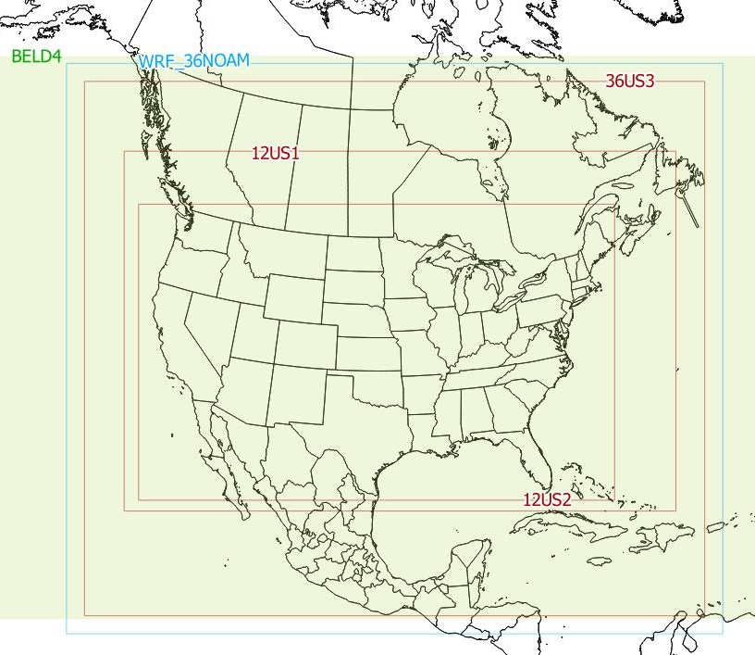
2016 modeling platform
Base year 2016
Same 12 km domain (12US2)
New 36 km domain (36US3)
More in-domain emissions
More in-domain chemistry
New large-scale simulations
Global Contributions and Lateral Boundary Conditions
GEOS-Chem global (not shown)
CMAQ Hemispheric
How do the large-scale simulations perform?

Slide 4
Large-scale Model Configurations
Versions, Meteorology, and Emissions

Slide 5
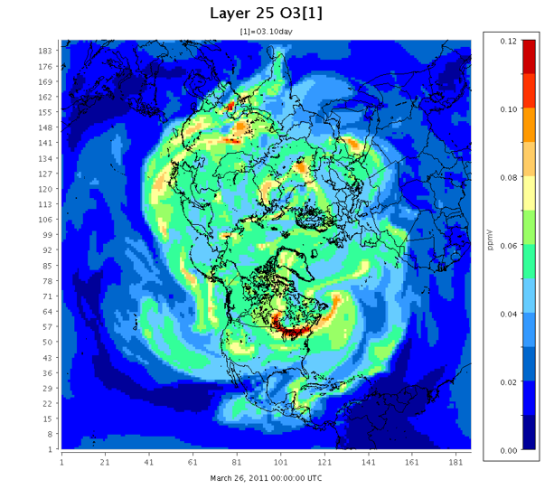
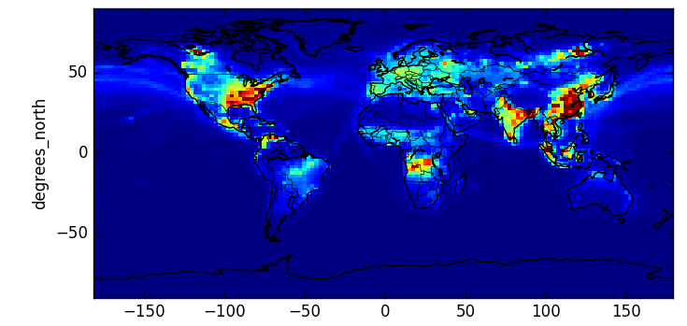
Hemispheric CMAQ
GEOS-Chem
v5.2.1 (IPV, dust, halogens)
8 month spinup period
Polar stereographic (~1x1 deg)
44 Layers up to 50mb
Weather Research and Forecasting
Version 12.0.1
1-year spinup period
2x2.5 degree w/ half polar cells
72 vertical layers up to 0.01mb
~38 up to 50mb
Goddard Earth Observing System (v5) “forward product”
Layer 25 (~ 600 mb)
Hourly O3 : 3/26 – 4/04/11

Slide 6
Natural Emissions
Biogenics (plants and soils):
BOTH: Model of Emissions of Gases and Aerosols from Nature (MEGAN) v2.1
H-CMAQ North America Biogenic Emission Inventory System (BEIS)
Wild and Prescribed Fires:
GEOS-Chem: 2011: GFED or 2-16: FINN v1.6
H-CMAQ: FINN v1.5 and over US 2016 platform
Lightning:
GEOS-Chem with Lee Murray updates
H-CMAQ GEIA climatological averages by latitude & season
Inline Dust:
GEOS-Chem: DEAD w/ current parameters
HCMAQ: Inline CMAQ algorithm
Sea Salt: similar in-line schemes
Dimethyl Sulfide
GEOS-Chem in-line
H-CMAQ not in present run
Relevant for aerosols and haze

Slide 7
Anthropogenic Emissions
Global
Regional
EDGAR-HTAP base year 2010
BOTH interpolated to 2014 by CEDS sector/country scalars
GEOS-Chem uses RETRO VOC
HCMAQ uses Pouliot sector-based speciation
Shipping:
HCMAQ: EDGAR-HTAP and 2016fe platform within Continental US modeling domain
GEOS-Chem: ARCTAS SO2, ICOADS CO, and over Europe from EMEP
Aircraft:
HCMAQ: EDGAR-HTAP
GEOS-Chem: AEIC
US: 2016fe Platform
Canada: EC 2013 interpolated
Mexico
Mobile 2016 MOVES
Other scaled from 2008
Asia (non-China): MIXv1
China: Tsinghua University (THU)
Lower sulfate than CEDS
Lower NOx than CEDS
Similar trends in power sector
Differences in metals where THU applies government required controls

Slide 8
Model Results (CMAQ-Only)
Seasonal Averages for Ozone
Sonde and CASTNet Evaluation
TOAR Qualitative Evaluation

Slide 9
Ozone Surface and about 5km Spring
Northern Hemisphere Spring (March April May, MAM) concentrations are relatively low with clear transport in the mid-troposphere seen most strongly in the southern latitudes
Surface
0.5 sigma or ~500hPa or 5km
Beijing

Slide 10
Ozone Surface and about 5km Summer
Northern Hemisphere Summer (June-July-August, JJA) concentrations are higher both at the surface and aloft., but the transport patterns are less clearly defined than spring.
Surface
0.5 sigma or ~500 hPa or ~5km
Beijing

Slide 11
WOUDC Sondes: by Site (all Times)
All World Ozone and Ultraviolet Data Center Sondes
Integrated within CMAQ sigma levels
Near tropopause bias that is strongest in the northern latitudes
<2x
<3/2 x
(80, 120) percent
>2/3 x
>1/2 x
-1 degrees
82 degrees
Observations
H-CMAQ
Ratio
Notes:
There appears to be a near tropopause bias that is strongest in the northern latitudes

Slide 12
WOUDC Sondes: by Time (all Sites)
<2x
Near tropopause bias is strongest in the spring. You can see that WRF-CMAQ does demonstrate increased downward mixing in March/April, but it appears muted compared to the sondes. Note also that the mid troposphere (600-400 hPa has a maximum in May in the sondes that is not present in CMAQ.
<3/2 x
(80, 120) %
>2/3 x
>1/2 x
Jan 1, 2016
Dec 31, 2017
Observations
H-CMAQ
Ratio
Notes:
The

Slide 13
CASTNet Observations
Often used as an imperfect surrogate for rural.
Model performance as a function of time
Hour of day
Day of year
Northern Hemisphere (Boreal) Seasons
Spring - March April May (MAM)
Summer - June July August (JJA)

Slide 14
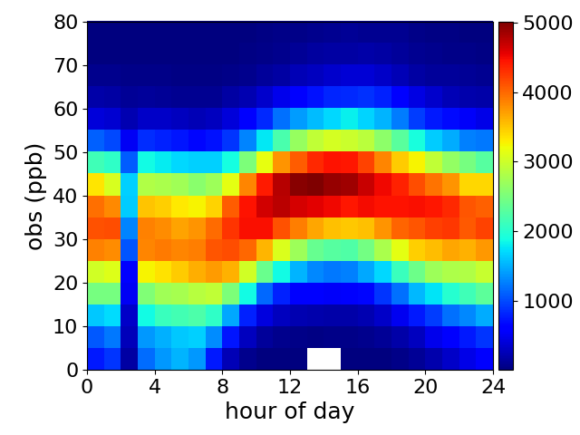
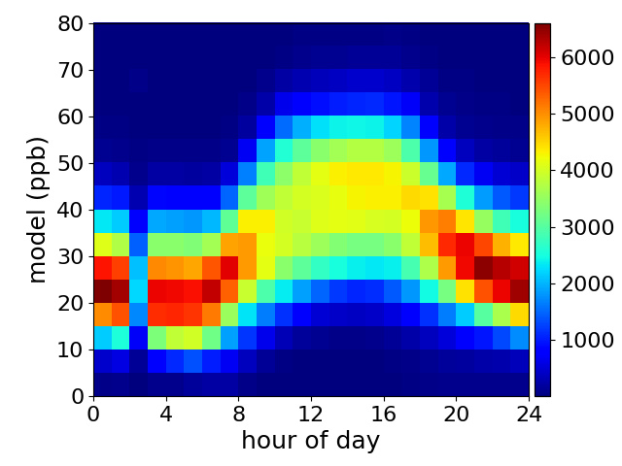
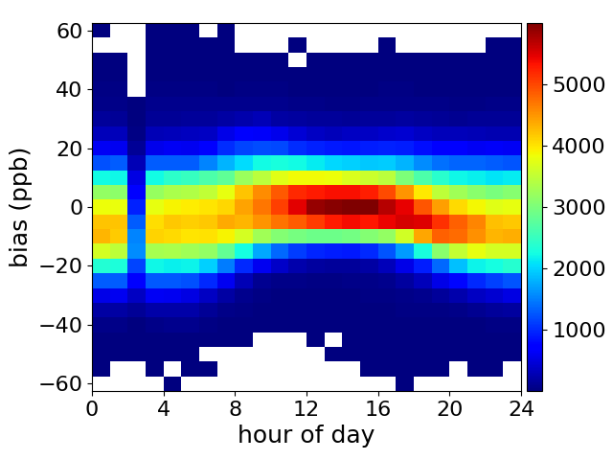
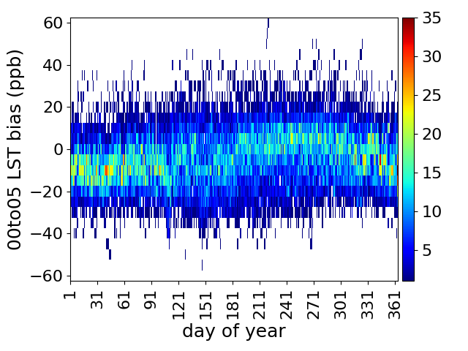
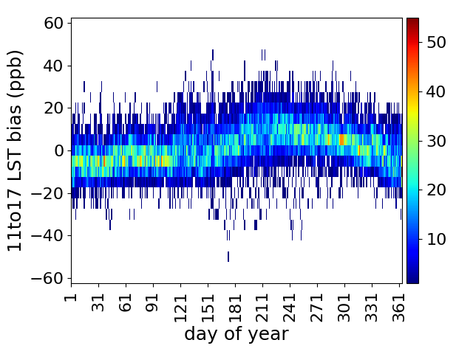
CASTNet Diurnal Performance
Obs
Mod
Bias
Bias 00-05LST
Bias 11-17LST
Plots show count of monitor-days with bias as a function of hour of day or day of year
Hour of day all year
0-5LST over the year
11-17LST over the year

Slide 15
CASTNet Monitors: All Year
CASTNet monitors are not all rural, but they are frequently used as a proxy. Here we evaluate hourly ozone.
15LST has an r=0.67
Performance at these monitors is within ±7.5 ppb at most monitors.
There is a west-east bias gradient
Notes:
CASTNet monitors are not all rural, but they are frequently used as a proxy

Slide 16
CASTNet Monitors: Spring
Spring (MAM) has a low-bias
15LST r=0.63
Majority of monitors within ±7.5 ppb
The west-east gradient is less strong than for the whole year

Slide 17
CASTNet Monitors: Summer
Summer (JJA)
15LST has an r=0.66
Majority of monitors within ±7.5 ppb.
The west-east bias gradient is most strongly present in the summer.

Slide 18
TOAR Database
Tropospheric Ozone Assessment Report
Strengths
Weaknesses
Global Coverage
Well categorized (urban/rural)
Easily available
Data stops in 2014
Gridded at 2x2 degrees
Perform a qualitative analysis
Where the 2016 is compared to 2010-2014,
but is only considered significant if outside the range of observations

Slide 19
TOAR Annual

Slide 20
TOAR April

Slide 21
TOAR July

Slide 22
Summary
Compares well to sondes in the mid troposphere
appears to have a near tropopause low-bias
low bias northward of 50 degrees Dec-May
performing similarly to GEOS-Chem used for the 2011 platform
Performs best in JJA compared to CASTNet
Most data is within 10 ppb of observations
Clear West-East bias gradient
TOAR evaluation suggests similar results with better performance at rural than urban monitors
Compared to current test of GEOS-Chem, results are more realistic.
H-CMAQ is low-biased while current GC simulation is high-biased compared to sondes
Updating GC version, considering meteorology

Slide 23
Next Steps
Provide boundary conditions for regional scale modeling.
Continue to evaluate, particularly for aerosols.
Estimate Ozone contributions from
Natural (global) sources
Anthropogenic
International sources
Domestic sources

